Slide 1


Slide 2
R O I
Face recognition based attendance and alert system

Slide 3
Abstract
A system which uses it’s face recognition ability to mark attendance in real time and alert parents about absent children
Helps save time and increases efficiency of classes
Developed with lots of lines of code in Python, OpenCV, MongoDB and with a little bit love
Easy to use

Slide 4
introduction
Why ?
What ?
How ?
Who ?

Slide 5
Existing system
Time consuming
Exhaustive
No alert facility
Complex to handle

Slide 6
Proposed system
Time saving
Easy to use
Efficient
Organized and centralized

Slide 7
Technologies used
Python
OpenCV
MongoDB
Some Secret Magic With a Pinch of Love

Slide 8
Dfd
Sorry Still working on it
I mean the data is flowing right ? Otherwise how could it work. But the flow hasn’t been captured yet to draw a diagram

Slide 9
Database design
Its MongoDB
So its NoSQL
Field | Type
Student ID | Integer (Primary Key)
Student Name | String
Student Mobile | Integer
Attendance Status | Object

Slide 10
Snaps

Slide 11
Future enhancement
ROI
Surveillance and Security system
An AI based Tracking and Prediction system

Slide 12
conclusion
ROI makes the process of attendance recording easier and faster
ROI is ready and set to Rock ‘n’ Roll
During the creation of ROI We’ve learned
Python
OpenCV
MongoDB
Tkinter

Slide 13
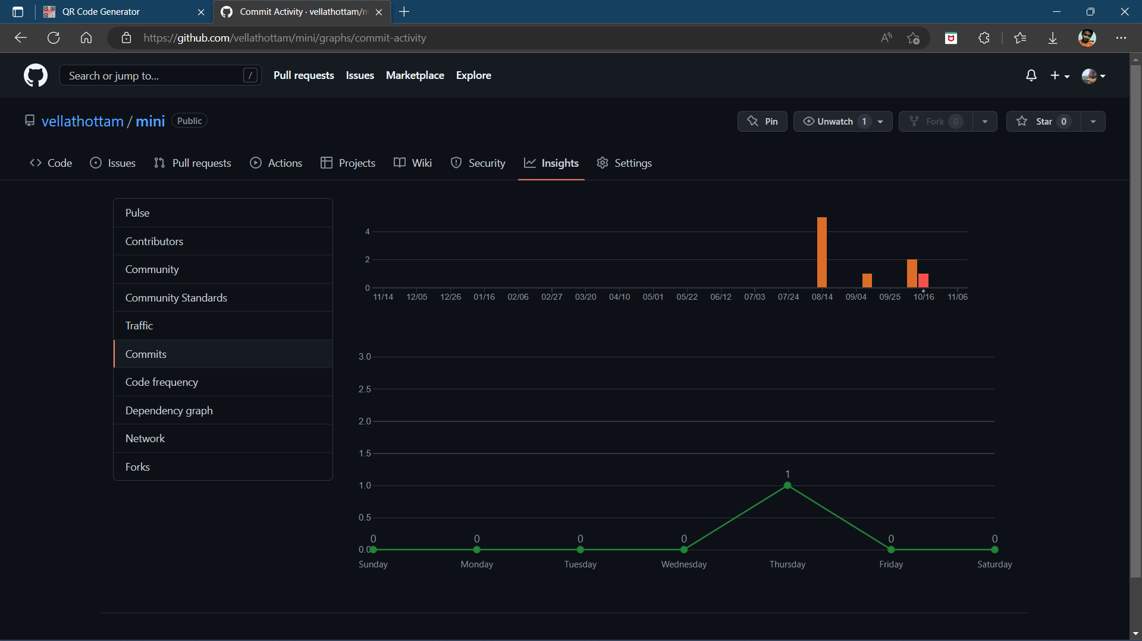
Git history

Slide 14

Thankyou Giants for your Shoulders

